Slide 1



Explainable AI for automated loan approval system

Slide 2

Title :- " EXPLAINABLE AI FOR AUTOMATED LOAN APPROVAL SYSTEM " Name of college: Yashoda Technical Campus Satara Name of Department: Computer Science And Engineering Name of students: 1. Aniket Kiran Shirke. 2. Mansi Rajendra Yadav. 3. Rutuja Yashwant Pise. 4. Sakshi Vijay Devkule. 5. Aditya Pradip Yadav. Name of guide: Prof. Chavan V. D

Slide 3
Abstract
This project aims to improve automated loan approval systems by using Explainable AI (XAI) techniques. These systems help financial institutions make faster and more efficient decisions. However, traditional machine learning models are often hard to explain, which can create trust issues with customers and regulators.
The project will use interpretable models, like decision trees and rule-based classifiers, along with tools like SHAP and LIME, to provide clear, understandable reasons for loan decisions. The goal is to balance accuracy with transparency, ensuring fairness, reducing biases, and meeting regulatory requirements, while improving trust and accountability in the loan approval process.

Slide 4
Index
Chapter 1 : Introduction
1.1 Introduction
1.2 Basic content
Chapter 2 : Literature Survey
Chapter 3 : Block Diagram
Chapter 4 : Scope of the project
4.1 Objectives & Motivation
4.2 Proposed work
Chapter 5 : Conclusion
Chapter 6 : Future Scope
References

Slide 5

Introduction
In recent years, the financial industry has increasingly adopted machine learning algorithms to automate the loan approval process. This automation helps financial institutions handle the growing volume of applications more efficiently, reduces operational costs, and speeds up decision-making. However, one of the major challenges in using machine learning models for loan approval is the lack of transparency. Most advanced models, such as deep learning and ensemble methods, are considered "black boxes," meaning that their decisions are difficult to interpret and explain to both customers and regulators.

Slide 6

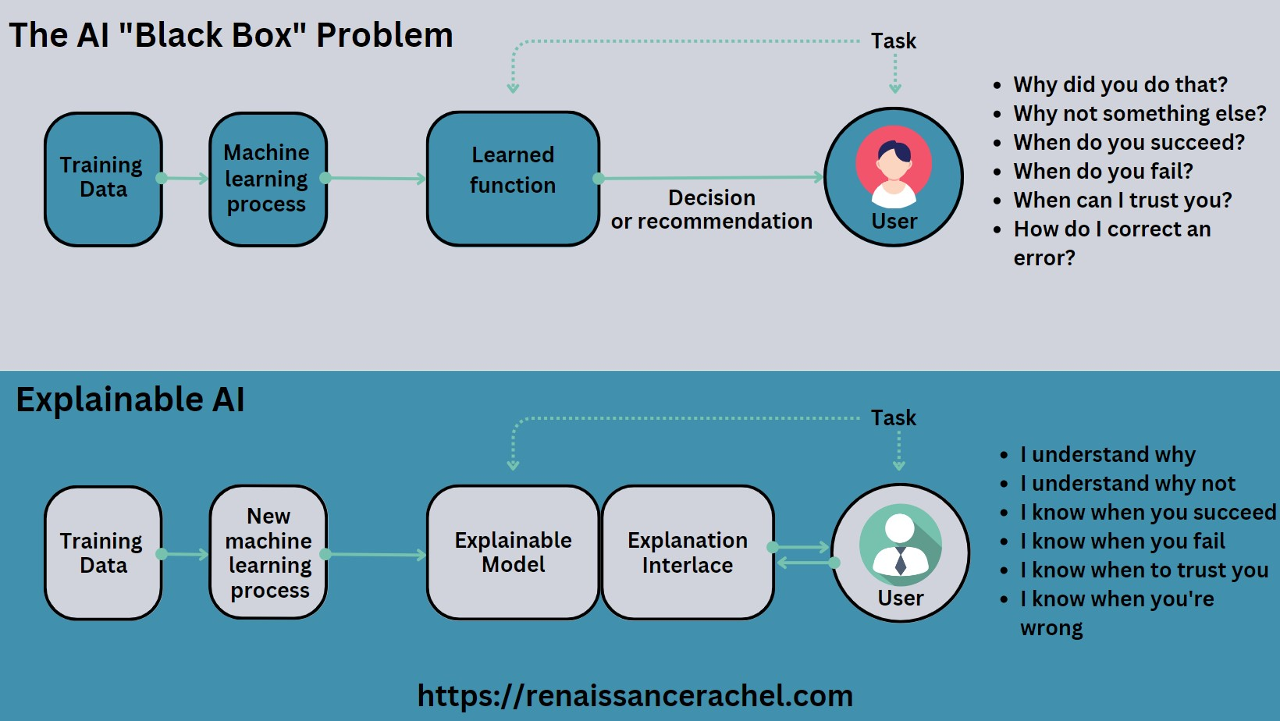



Problem identification in loan system

Slide 7
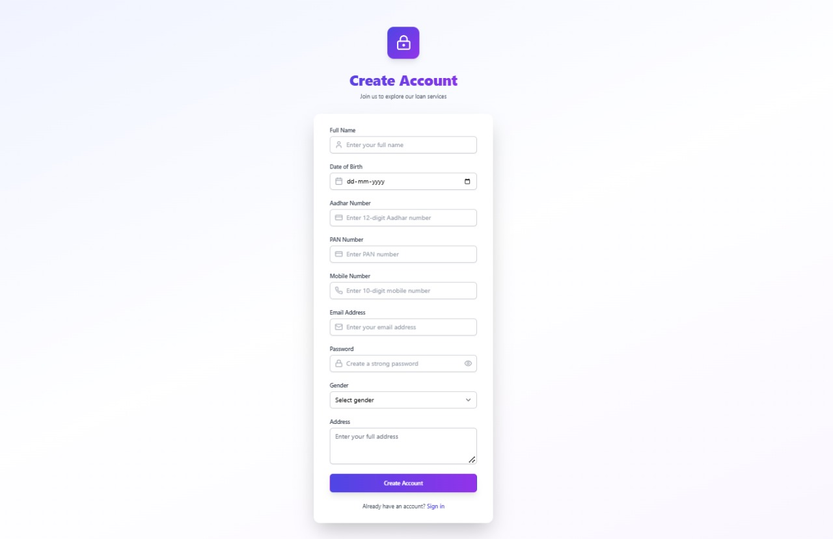
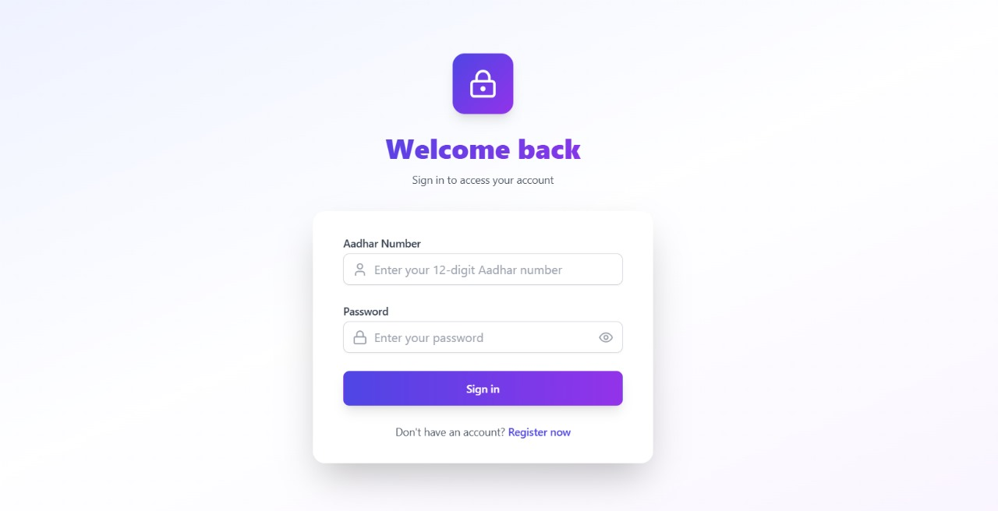
Working Process

Slide 8
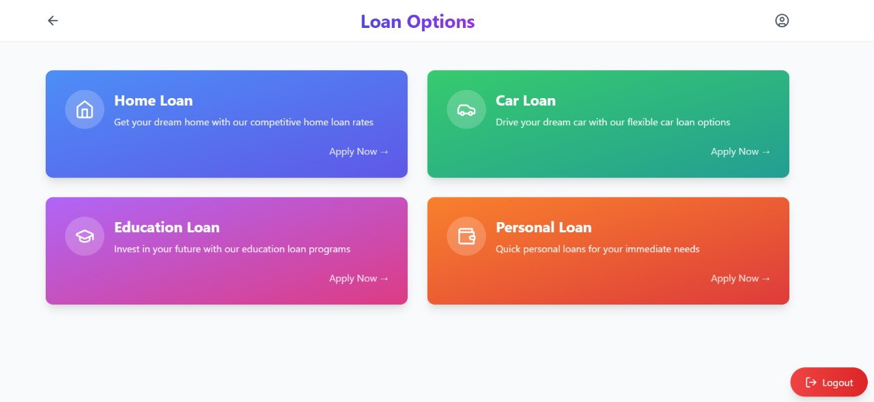
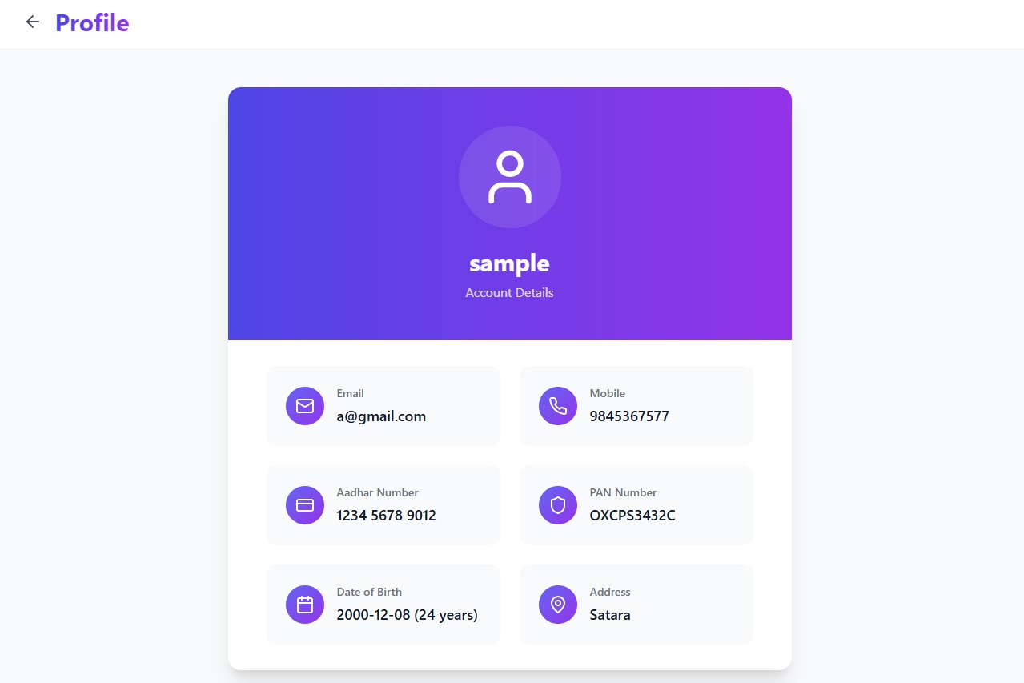

Slide 9
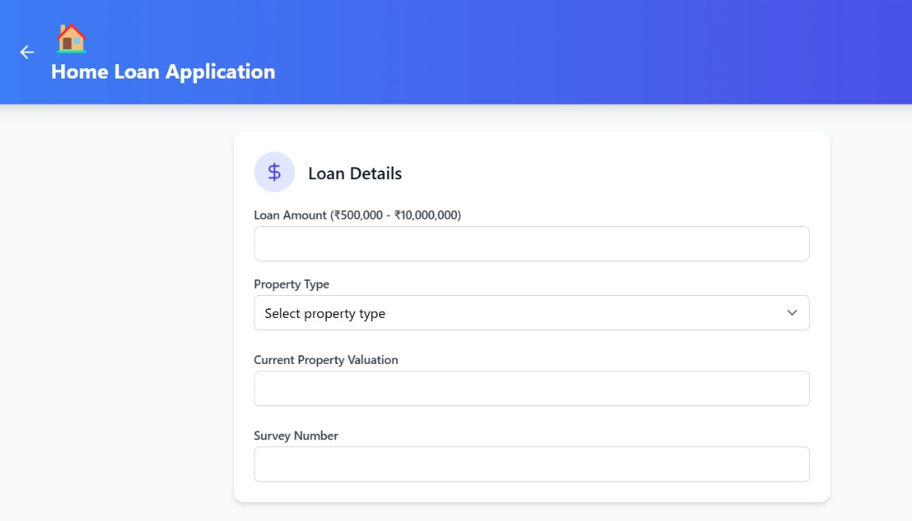
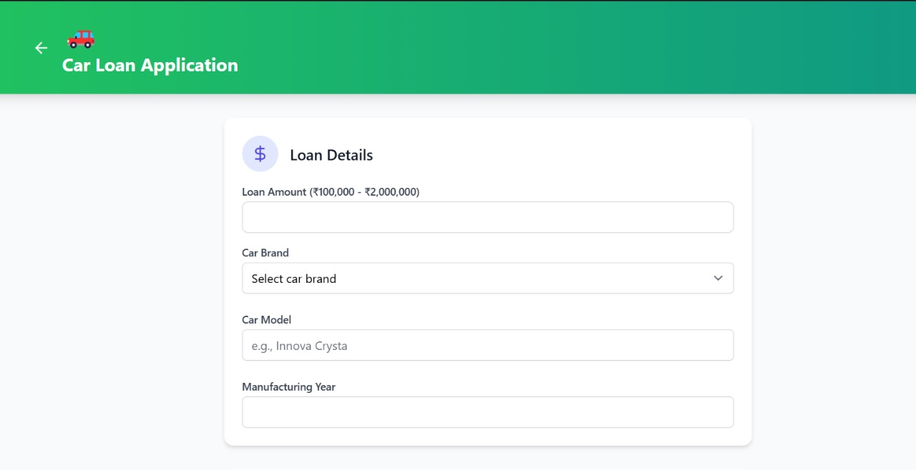
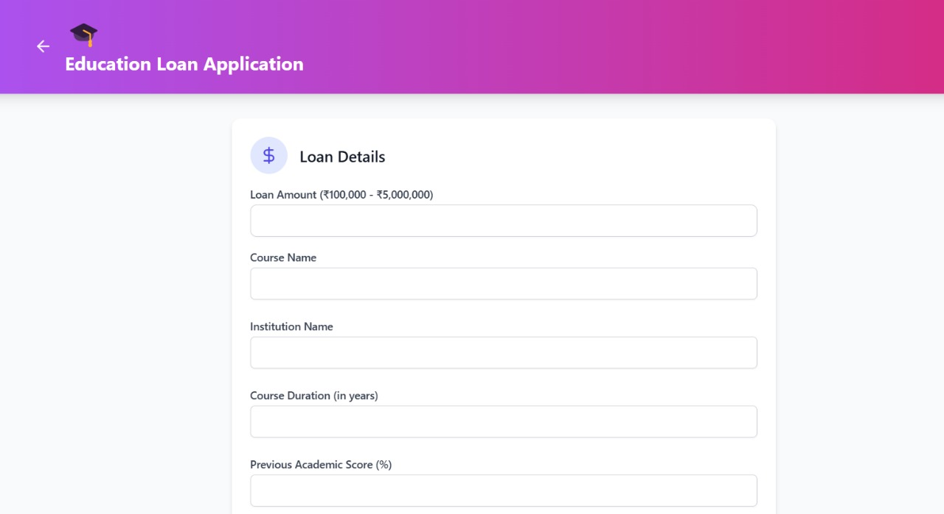
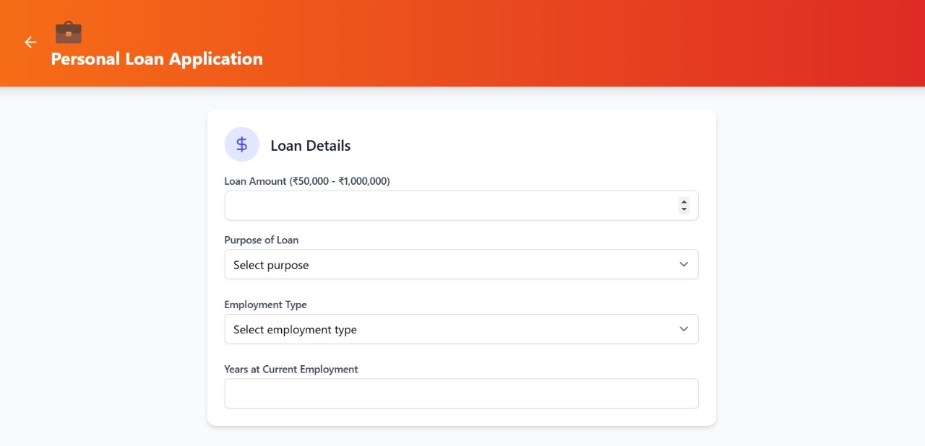

Slide 10
Literature Review
[1]. Explainable Artificial Intelligence-Based Decision Support Systems: A Recent Review The paper provides a comprehensive survey on the integration of Explainable Artificial Intelligence (XAI) within Decision Support Systems (DSSs).
[2]. Future of loan approvals with explainable ai: The paper discusses the growing role of Explainable AI (XAI) in automating the loan approval process, particularly in the context of underwriting.
[3]. Explainable Artificial Intelligence (XAI): From Theory to Methods and Applications: This paper focuses on Explainable Artificial Intelligence (XAI), emphasizing the importance of interpreting machine learning decisions, especially in sensitive domains.
[4]. Explainable machine learning in materials science: This literature discusses the limitations of traditional materials science, which relies heavily on expert knowledge for predicting material 3 properties.

Slide 11
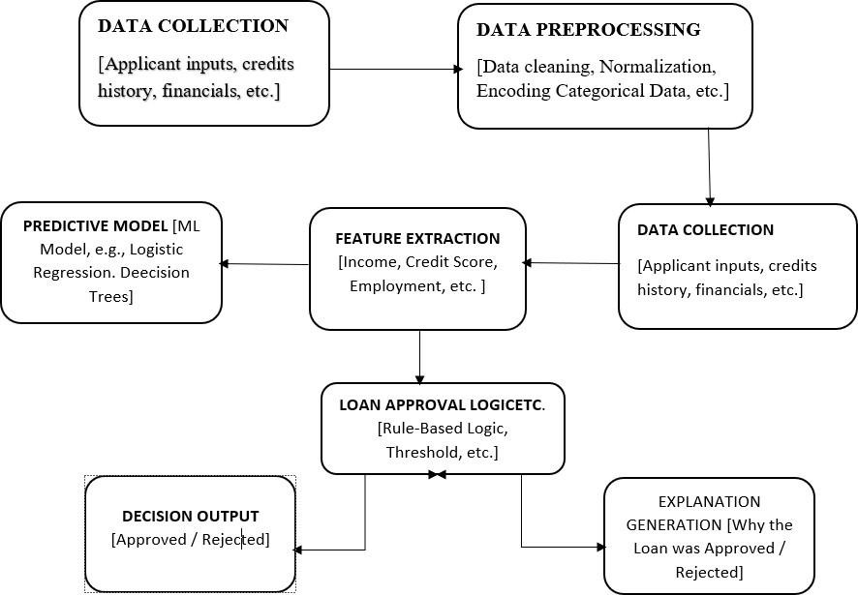
Block Diagram

Slide 12

Scope of Project
2. Fairness and Bias Mitigation
3. Regulatory Compliance
1.Transparency
4.Trust and Customer Satisfaction
5.Model Improvement
6.Accountability

Slide 13
Objective
1. Data Preprocessing : Clean and preprocess applicant data, including income, credit score, employment history, debt-to-income ratio, and other relevant factors. Engineer meaningful features that enhance model performance and interpretability, while ensuring data is unbiased and representative.
2. Model Selection and Development :Choose or develop machine learning models that are interpretable or can be made explainable, such as decision trees, logistic regression, or gradient boosting models. Train and validate the model on historical loan application data to predict loan approval outcomes with high accuracy.
3. Bias Detection and Fairness Monitoring: Incorporate bias detection mechanisms to identify any potential discrimination against specific groups (e.g., age, gender, or race). Apply fairness-enhancing techniques to mitigate any detected biases and ensure equitable decisions.
4. Human Oversight and Override Mechanism :Build an interface for loan officers to review, understand, and, if necessary, override the AI decisions, allowing human judgment to intervene when needed.
5. User-Friendly Interface for Transparency :Design a dashboard or report generation feature that shows applicants and loan officers why a decision was made in clear, non-technical terms . Include visual aids like bar charts or factor rankings to illustrate key influences on the decision.
6. Compliance and Audit Logs : Implement logging and auditing functionalities to record decision-making processes and ensure compliance with industry regulations, enabling easy inspection if needed.

Slide 14
Proposed work
The proposed work for the Explainable AI for Automated Loan Approval System involves several stages to ensure the AI model is accurate, fair, and transparent. Here’s a breakdown of the key steps:
1. Problem Definition and Requirement Gathering
2. Data Collection and Preprocessing
3. Model Selection and Development
4. Bias Detection and Mitigation
5. User Interface and Visualization Development

Slide 15
Motivation for work
i. Increasing Demand for Transparency: Consumers and regulators are demanding greater transparency in automated decision-making processes, particularly in finance.
ii. Complexity of AI Models: Many advanced AI models (e.g., deep learning) function as black boxes making it challenging to interpret their decisions. Explainable AI addresses this issue by offering clear explanations, allowing users to understand the reasoning behind loan approvals or denials.
ii. Complexity of AI Models: The financial industry has faced scrutiny over biased lending practices. Implementing explainable AI can help identify and mitigate biases in loan approval systems, ensuring fair treatment of all applicants regardless of their background.
iv. Regulatory Compliance: Regulatory bodies are increasingly requiring financial institutions to provide explanations for their decisions, particularly concerning credit scoring and loan approvals. An explainable AI system ensures compliance with these regulations, reducing the risk of legal repercussions.
v. Enhancing User Experience: Clear explanations can significantly enhance the user experience for loan applicants. By understanding the factors that influenced their loan decisions, applicants can make informed financial decisions and improve their creditworthiness in the future.

Slide 16
Conclusion & Future scope
The Explainable AI for Automated Loan Approval System provides a transparent, fair, and efficient solution to loan decision-making, ensuring that both applicants and financial institutions understand the reasoning behind approval or rejection. By incorporating explainability techniques, such as SHAP or LIME, the system enhances trust and helps to eliminate biases, ensuring equitable treatment for all users. This approach not only fosters regulatory compliance but also contributes to a more inclusive financial environment. In the future, the system can evolve to support a broader range of loan types, including microloans or personal loans, and incorporate alternative data sources like social media activity or transaction history.
Additionally, the system could be enhanced to adapt to regional regulations and specific financial needs across different markets. Advanced explainability methods, like interactive visualizations or more complex models, could further improve user understanding and decision- making. This continued evolution promises a more efficient, fair, and transparent financial ecosystem, benefiting both individuals and financial institutions while maintaining a focus on fairness, inclusivity, and compliance.

Slide 17
References
[1]. "Explainable Artificial Intelligence-Based Decision Support Systems:" A Recent Review Georgios Kostopoulos 1,2 , Gregory Davrazos 2 and Sotiris Kotsiantis 2, Electronics 2024, 13, 2842.
[2]. "Future of loan approvals with explainable ai:" PG Student of MCA, Dantuluri Narayana Raju College, Bhimavaram, Andharapradesh.vol 15issue 07 /2024
[3]." EXplainable Artificial Intelligence (XAI)—From Theory to Methods and Applications "Received 22 May 2024, accepted 3 June 2024, date of publication 5 June 2024, date of current version 14 June 2024.Digital Object Identifier 10.1109/ACCESS.2024.3409843
[4]. x. zhong, b. gallagher, s. liu, b. kailkhura, a. hiszpanski, and t. y.-j. han, ‘‘explainable machine learning in materials science,’’ npj comput. mater., vol. 8, no. 1, p. 204, sep. 2022.
[5]." Peeking Inside the Black-Box: A Survey on Explainable Artificial Intelligence (XAI):" Received August 5, 2018, accepted September 4, 2018, date of publication September 17, 2018, date of current version October 12, 2018.Digital Object Identifier 10.1109/ACCESS.2018.287005

Slide 18

Thank You!

